Slide 1

OS - Chapter 5
Prepared By : Sheetal J. Nagar,
Atmiya Institute of Technology & Science, Rajkot.

Slide 2
Page Replacement Algorithms
First In First Out
Second Chance
Clock Page Replacement
Optimal Page Replacement
LRU (Least Recently Used)
NRU (Not Recently Used)

Slide 3
1) First In First Out
The simplest page replacement algorithm.
OS maintains a list of all pages currently in memory, with the most recently arrived page at the tail and least recent at the head.
On a page fault, the page at head is removed and the new page is added to the tail.
When a page replacement is required the oldest page in memory needs to be replaced.
The performance of the FIFO algorithm is not always good because it may happen that the page which is the oldest is frequently referred by OS.
Hence removing the oldest page may create page fault again.

Slide 4
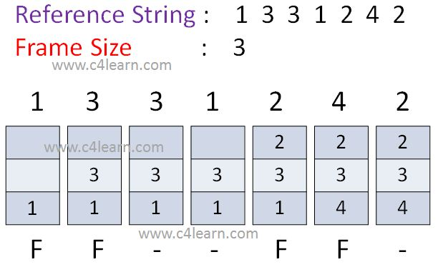
First In First Out (Example 1)
1
1
3
1
3
1
3
1
3
2
4
3
2
4
3
2
F
F
F
F
Total No. of Page Faults : 4

Slide 5
First In First Out (Example 2)
Reference String : 1 2 3 4 2 1 5 6 2 1
Frame Size : 4
1 2 3 4 2 1 5 6 2 1
1
1
2
1
2
3
1
2
3
4
1
2
3
4
1
2
3
4
5
2
3
4
5
6
3
4
5
6
2
4
5
6
2
1
F
F
F
F
F
F
F
F
Total No. of Page Faults : 8

Slide 6
Belady’s Anomaly
We would expect that giving more no. of page frames would improve the performance.
“But a situation in which if no. of page frames increases then no. of page faults also increases, this situation is known as Belady’s Anomaly”.
This situation is commonly encountered with FIFO page replacement algorithm, the page-fault rate may increase as the number of allocated frames increases.
Let’s consider an example for Belady’s Anomaly in which
  Total no of page faults using 3 frames = 9
  Total no of page faults using 4 frames = 10

Slide 7
First In First Out (Example 3)
Reference String : 1, 2, 3, 4, 1, 2, 5, 1, 2, 3, 4, 5
Frame Size : 3
1 2 3 4 1 2 5 1 2 3 4 5
1
1
2
1
2
3
4
2
3
4
1
3
4
1
2
5
1
2
5
1
2
5
1
2
5
3
2
5
3
4
5
3
4
F
F
F
F
F
F
F
F
F
Total No. of Page Faults : 9

Slide 8
First In First Out (Example 3)
Reference String : 1 2 3 4 1 2 5 1 2 3 4 5
Frame Size : 4
1 2 3 4 1 2 5 1 2 3 4 5
1
1
2
1
2
3
1
2
3
4
1
2
3
4
1
2
3
4
5
2
3
4
5
1
3
4
5
1
2
4
5
1
2
3
4
1
2
3
4
5
2
3
F
F
F
F
F
F
F
F
F
F
Total No. of Page Faults : 10

Slide 9
2) Second Chance
A simple modification to FIFO that avoids the problem of throwing out a heavily used page is to inspect the R bit of the oldest page.
If (R bit is 0)
{
  the page is both old and unused, so it is replaced immediately.
  }
  If (R bit is 1)
  {
  R bit is cleared.
  The page is put onto the end of the list of pages, and
  Its load time is updated as though it had just arrived in memory.
  Then the search continues.
  }

Slide 10
The operation of this algorithm is called second chance.
What second chance is looking for is an old page that has not been referenced in the most recent clock interval.
If all the pages have been referenced, second chance degenerates into pure FIFO.

Slide 11
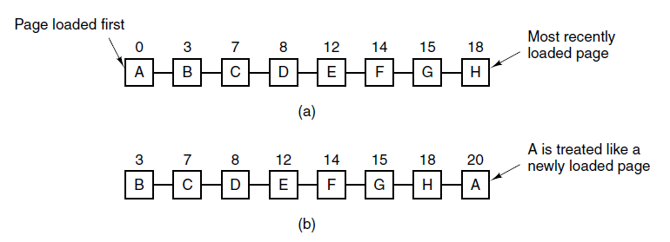
Figure :Operation of second chance.
Pages sorted in FIFO order.
Page list if a page fault occurs at time 20 and A has its R bit set.
The numbers above the pages are their loading times.

Slide 12
3) Clock Page Replacement Algorithm
Although second chance is a reasonable algorithm, it is unnecessarily inefficient because it is constantly moving pages around on its list.
A better approach is to keep all the page frames on a circular list in the form of a clock, as shown in Figure.
A hand points to the oldest page.
When a page fault occurs, the page being pointed to by the hand is inspected.
This algorithm is called “clock”.
It differs from second chance only in the implementation.

Slide 13
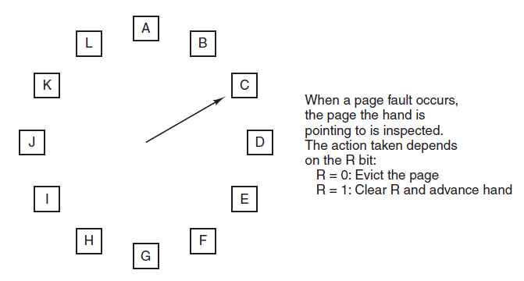

Slide 14
If (R bit is 0)
{
  Current page is removed,
New page is inserted into the clock in its place.
The Hand and is advanced to the next page.
  }
  If (R bit is 1)
  {
R bit is cleared.
The hand is advanced to the next page.
This process is repeated until a page is found with R = 0.
}

Slide 15
4) Optimal Page Replacement
moment a page fault occurs, some set of pages will be in the memory.
One of these pages will be referenced on the very next instruction.
Other pages may not be referenced until 10, 100, or perhaps 1000 instructions later.
Each page can be labeled with the number of instructions that will be executed before that page is first referenced.
The optimal page algorithm simply says that the page with the highest label should be removed.

Slide 16
Problems with Optimal Page Replacement
It is unrealizable.
At the time of the page fault, the operating system has no way of knowing when each of the pages will be referenced next.

Slide 17
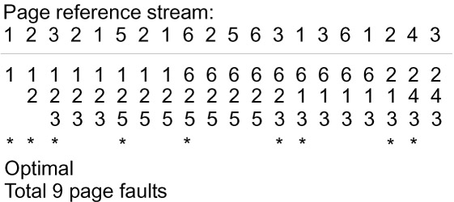
Optimal Page Replacement (Example 1)
Reference String : 1 2 3 2 1 5 2 1 6 2 5 6 3 2
Frame Size : 3
1 2 3 2 1 5 2 1 6 2 5 6 3 2
F
F
F
F
F
F

Slide 18
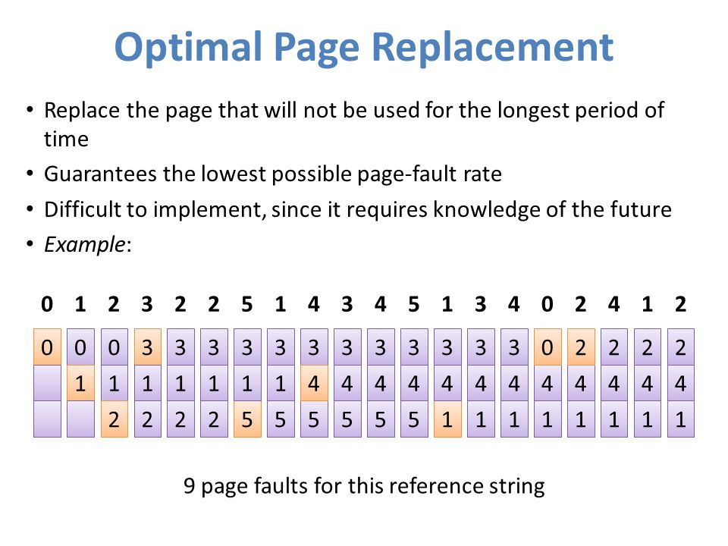
Optimal Page Replacement (Example 2)
Reference String : 0 1 2 3 2 2 5 1 4 3 4 5 1 3 4 0 2 4 1 2
Frame Size : 3
Total No. of Page Faults : 9

Slide 19
5) Least Recently Used (LRU)
A good approximation to the optimal algorithm is based on the observation that pages that have been heavily used in last few instructions will probably be heavily used again in next few instructions.
When page fault occurs, throw out the page that has been used for the longest time. This strategy is called LRU (Least Recently Used) paging.
To fully implement LRU, it is necessary to maintain a linked list of all pages in memory, with the most recently used page at the front and the least recently used page at the rear.

Slide 20
The list must be updated on every memory reference.
LRU is implemented with a special hardware.
For a machine with n page frames, the LRU hardware can maintain a matrix of n × n bits, initially all zero.
Whenever page frame k is referenced:
1) The hardware first sets all the bits of row k to 1, and
2) Then sets all the bits of column k to 0.
“At any instant, the row whose binary value is lowest is the least recently used; the row whose value is next lowest is next least recently used, and so forth”.

Slide 21
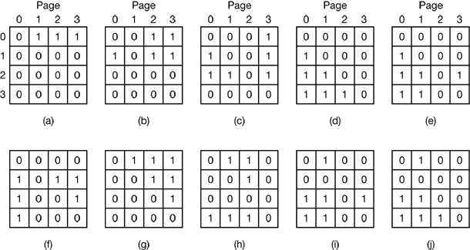
  Page references in the order : 0 1 2 3 2 1 0 3 2 3
  No. of Page Frames : 4

Slide 22
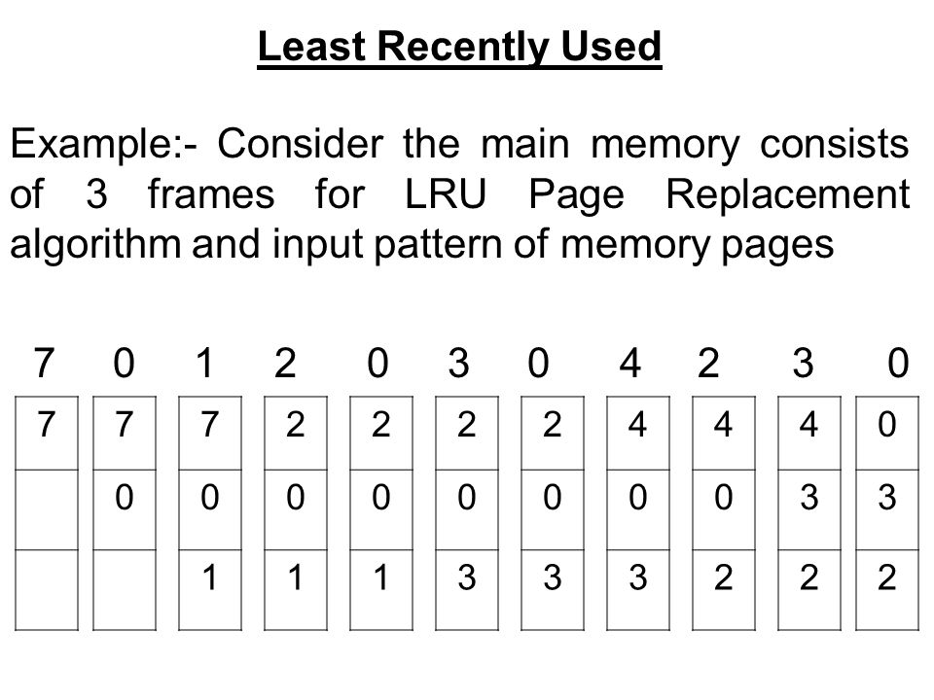
LRU Page Replacement (Example)
Reference String : 7 0 1 2 0 3 0 4 2 3 0
Frame Size : 3
F
F
F
F
F
F
F
F
F
Total No. of Page Faults : 9

Slide 23
6) Not Recently Used (NRU)
NRU makes approximation to replace the page based on R and M bits.
R bit is set when a page is Referenced.
M bit is set when a page is Modified.
When a process is started up, both bits for all pages are set to 0 by operating system.
Periodically (e.g., on each clock interrupt), the R bit is cleared, to distinguish pages that have not been referenced recently from those that have been.

Slide 24
When page fault occurs, the operating system inspects all the pages and divide them into 4 categories based on current values of their R and M bits
    Case 0 : not referenced, not modified
    Case 1 : not referenced, modified
    Case 2 : referenced, not modified
    Case 3 : referenced, modified
    The NRU (Not Recently Used) algorithm removes a page at random from the lowest numbered nonempty class.

Slide 25
Reference Books:
    “Modern Operating Systems” by Andrew S Tanenbaum
    “Operating System Concepts” by Silberschatz, Peter B. Galvin and Greg Gagne

